Slide 1
The problem
acidoCEST MRI has shown to be solve a valuable tool to measure pH of several tissues accurately and with minor invasiveness.
The extraction of pH from a CEST spectra is usually done following a linear model developed by Pagel et al. However, this method has two limitations:
It does not consider variations in the CEST spectra that are NOT easily discernible by visual inspection or Lorentzian fitting
It assumes a linear relationship between the features extracted from a CEST spectra and the observed pH.
In this work, we propose to address these two limitations by:
Using all available information in the CEST spectra as a possible predictor of pH (with and without dimensionality reduction)
Creating flexible models that do not require a linear assumption between predictors and pH

Slide 2
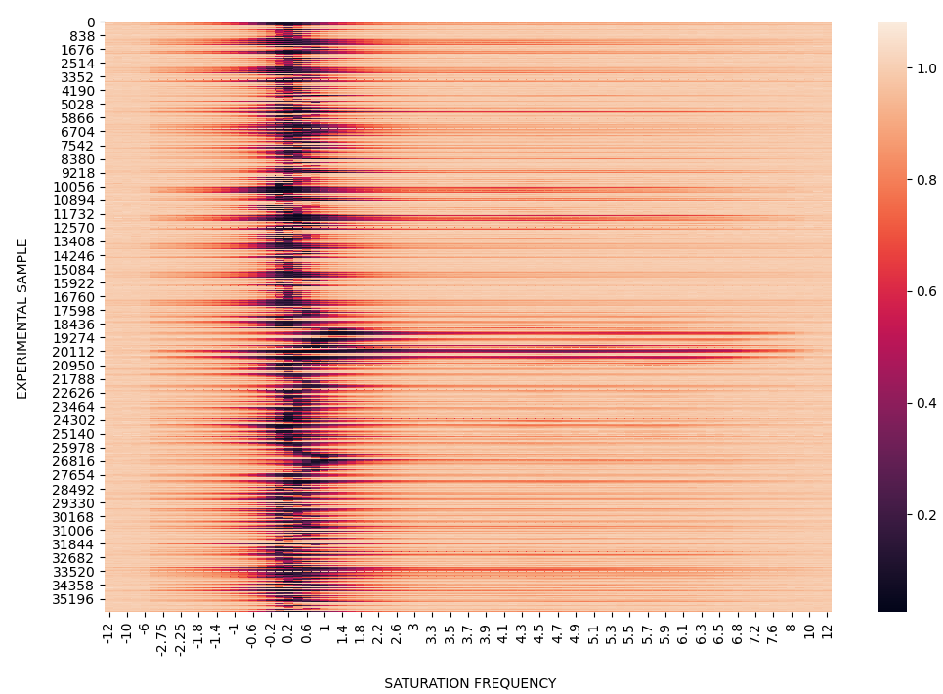
Our strategy
split
2
Testing data
1
2
Training data
4
3
Train model
4
Test model
Classification
Or
Regression
36,000 CEST spectra with 81 frequencies each
6 saturation times
6 saturation powers
T1, T2, B1, and B0 for all samples

Slide 3
Results
81

Slide 4
Results
Use only stat frequencies selected by the method on slide 6

